Slide 1
D7047E Group 15
Adesijibomi Aderinto Oghenero Jeremiah Opia

Slide 2
Objectives
General information about the project.
Project goals:
Binary sentimental classification between hate and non hate speech.
Data Sources:
Automated Hate Speech Detection and the Problem of Offensive Language (MrMorj 2022)
DistilBert pretrained model (Sanh et al. 2019)
Test evaluation data (Yer 2020)
Methodology:
Custom LSTM-based Keras model
Pretrained DistilBERT (Hugging Face).

Slide 3
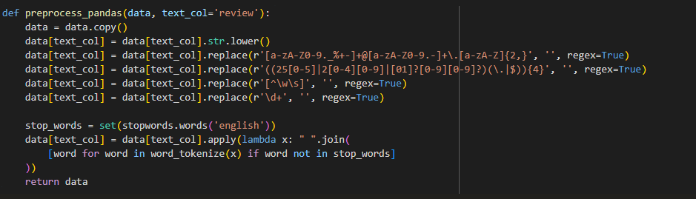
Data preprocessing
Text Preprocessing: Removes;
Removes Emails
Removes IP addresses
Removes Punctuation
Removes Numbers
Removes stopwords using NLTK
Tokenizes words.

Slide 4
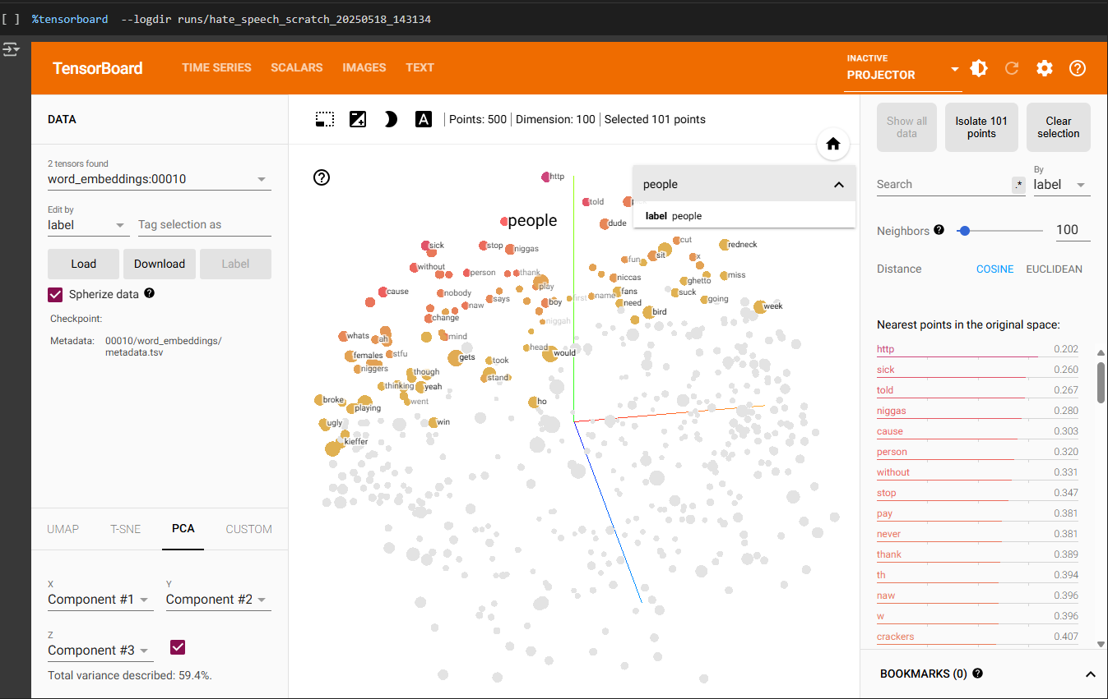
1. Model Training and Logging
Custom Bidirectional LSTM model using Amazon hate speech data:
Uses Tokenizer and pad_sequences.
Train/val/test split.
Simple architecture: Embedding → BiLSTM → Dense.
Uses binary_crossentropy, tracks accuracy.
Logs:
Loss/accuracy (train & val) to TensorBoard.
Confusion matrix
Word & sentence embeddings
Text predictions with probabilities

Slide 5
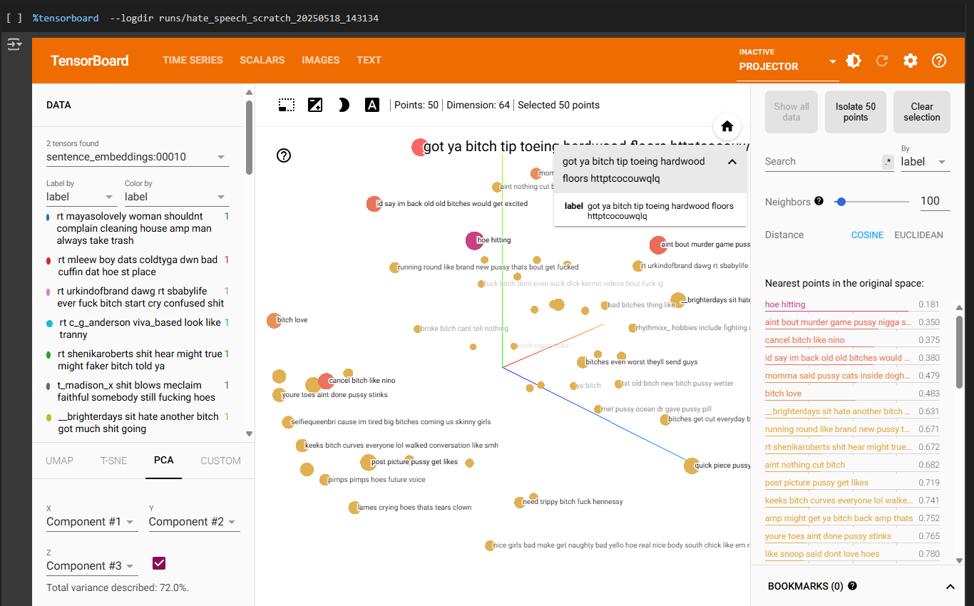
Sentence Embeddings for Bidirectional LSTM

Slide 6
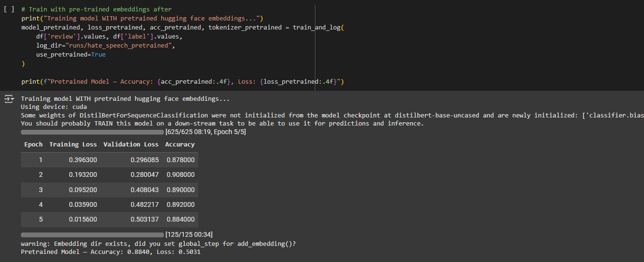
2. Pretrained DistilBERT model (if use_pretrained=True)
Loads Amazon Polarity dataset (subset).
Tokenized using DistilBertTokenizerFast.
Sets class weights to handle imbalance.
Uses Hugging Face’s Trainer with a custom WeightedLossTrainer.
Logs:
Train/test accuracy to TensorBoard
Test set embeddings (from CLS token)

Slide 7
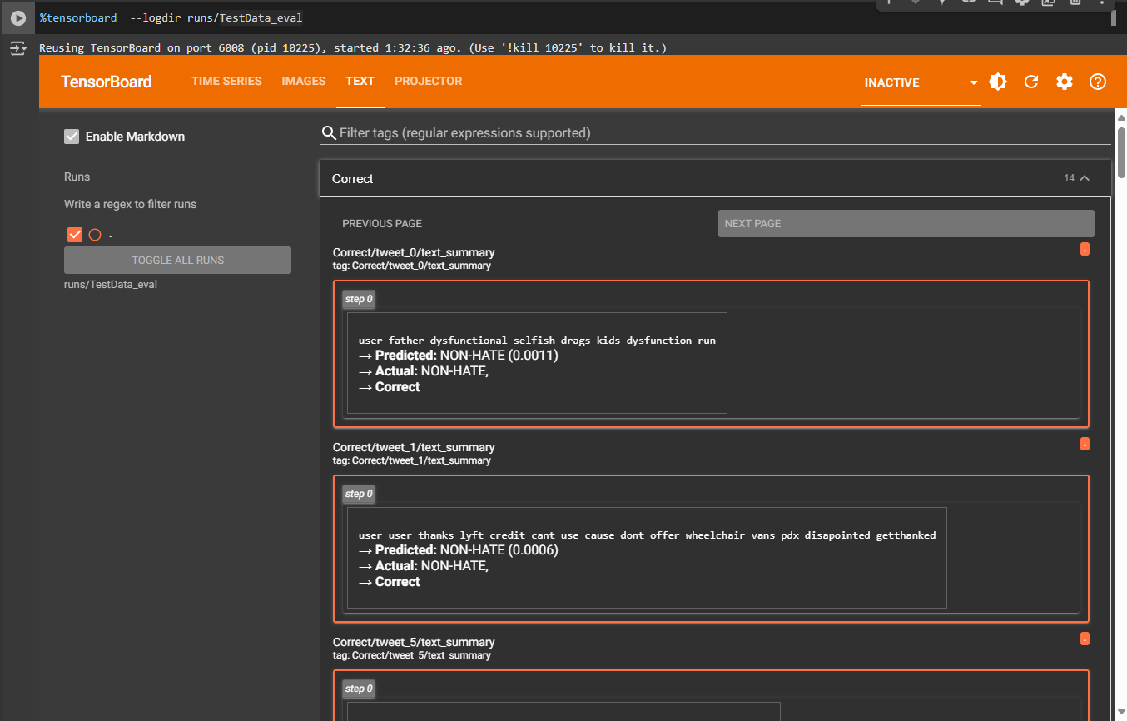
3. Evaluation on Unlabeled Data:
Preprocesses and tokenizes new input data.
Runs model inference on either:
Keras model: generates predictions, sentence embeddings
Pretrained model: uses BERT’s CLS token output as embeddings
Logs to TensorBoard:
Predictions and probabilities
Text with predicted vs. true labels
Confusion matrix

Slide 8
Reference
MrMorj. 2022. “Twitter Sentiment Analysis for Hate Speech Detection.” https://www.kaggle.com/code/mrmorj/twitter-sentiment-analysis-hatred-speech.
Sanh, Victor, Lysandre Debut, Julien Chaumond, and Thomas Wolf. 2019. “DistilBERT, a Distilled Version of BERT: Smaller, Faster, Cheaper and Lighter.” arXiv Preprint arXiv:1910.01108. https://arxiv.org/abs/1910.01108.
Yer, Ashwini. 2020. “Toxic, Hate and Offensive Tweets Dataset.” https://www.kaggle.com/datasets/ashwiniyer176/toxic-hate-and-offensive-comments.

